Slide 1
CS 341 Lab 8
Fall 2020

Slide 2
Lab 8
Goal: learn about waves and create a frequency meter

Slide 3
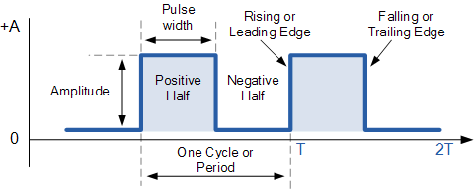
Waves
Pulse Width: how long the signal remains HIGH
Period: The time it takes for the wave to repeat
Frequency: 1/Period
We can think of frequency as a measure of how dense the wave is

Slide 4
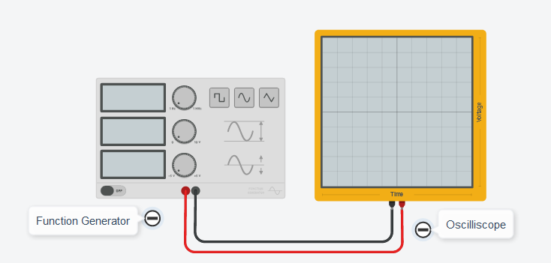
Function Generator
Outputs a wave-like electrical signal
Settings:
Frequency: how many times the wave will be repeated in 1 second
Amplitude: The difference in voltage between the top of the wave and the bottom of the wave
DC Offset: the voltage amount that the wave is centered at
Function: change between rectangular, smooth, or triangular wave

Slide 5
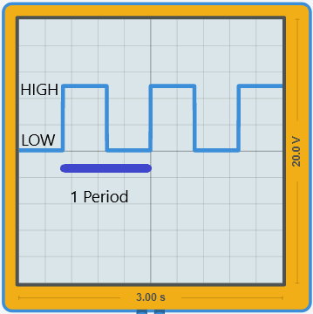
Oscilloscope
Display for visualizing waves

Slide 6
Part 1 (optional)
Experiment with the function generator and oscilloscope
If the relationship between frequency, period, and pulse width is still a bit confusing, this is a good way to get some intuition

Slide 7
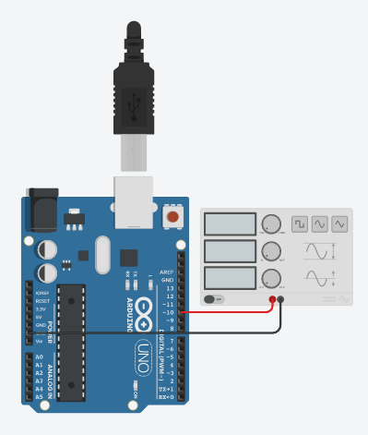
Part 2
Create an Arduino program that reads a digital signal and calculates:
Period
Frequency
Some tips
Display numbers in seconds
Serial.println(frequency, 5);
Be careful of division between two integers

